Slide 1


Slide 2
Chapter 16
Wave Motion

Slide 3
What is a wave?
Wave:
Traveling disturbance that transport energy but not matter.
Or
A wave is a periodic disturbance traveling through a medium that transport energy but not matter.

Slide 4
Types of Waves
There are Three main types of waves
  Mechanical waves
    Some physical medium is being disturbed
    The wave is the propagation of a disturbance through a medium
  Electromagnetic waves
    No medium required
    Examples are light, radio waves, x-rays
  Matter Waves
    In quantum mechanics particles exhibit wave-like properties and visa versa.
    Each particle has a wave associated with it.

Slide 5
General Features of Waves
In wave motion, energy is transferred over a distance
Matter is not transferred over a distance
All waves carry energy
  The amount of energy and the mechanism responsible for the transport of the energy differ

Slide 6
Mechanical Wave Requirements
Some source of disturbance
A medium that can be disturbed
Some physical mechanism through which elements of the medium can influence each other

Slide 7
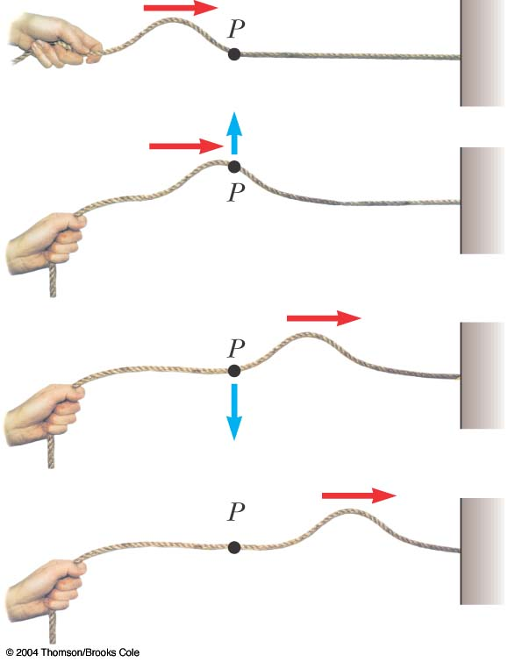
Pulse on a Rope
The wave is generated by a flick on one end of the rope
The rope is under tension
A single bump is formed and travels along the rope
  The bump is called a pulse

Slide 8
Pulse on a Rope
The rope is the medium through which the pulse travels
The pulse has a definite height
The pulse has a definite speed of propagation along the medium
A continuous flicking of the rope would produce a periodic disturbance which would form a wave

Slide 9
Transverse Wave
A traveling wave or pulse that causes the elements of the disturbed medium to move perpendicular to the direction of propagation is called a transverse wave
The particle motion is shown by the blue arrow
The direction of propagation is shown by the red arrow

Slide 10
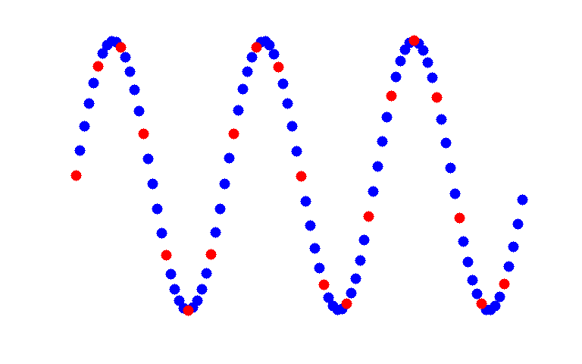
travelling transverse wave

Slide 11
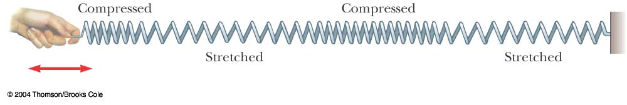
Longitudinal Wave
A traveling wave or pulse that causes the elements of the disturbed medium to move parallel to the direction of propagation is called a longitudinal wave
The displacement of the coils is parallel to the propagation

Slide 12
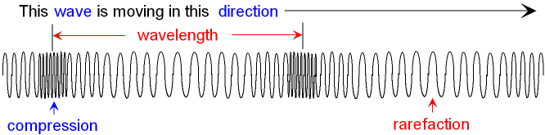

Sound wave travelling through the air

Slide 13
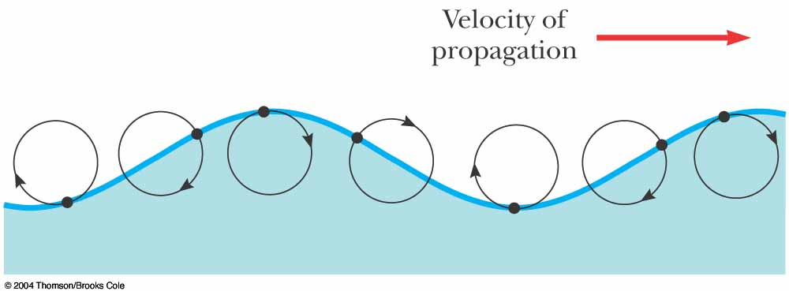
Complex Waves
Some waves exhibit a combination of transverse and longitudinal waves
Surface water waves are an example

Slide 14
Example: Earthquake Waves
P waves
  “P” stands for primary
  Fastest, at 7 – 8 km / s
  longitudinal waves that travel through the body of the Earth.
S waves
  “S” stands for secondary
  Slower, at 4 – 5 km/s
  transverse waves that travel through the body of the Earth.
  A seismograph records the waves and allows determination of information about the earthquake’s place of origin

Slide 15

Example: Earthquake Waves
L waves (surface waves)
Travel along the Earth’s surface. The motion is essentially elliptical (transverse + longitudinal). These waves are mainly responsible for the damage caused by earthquakes.

Slide 16
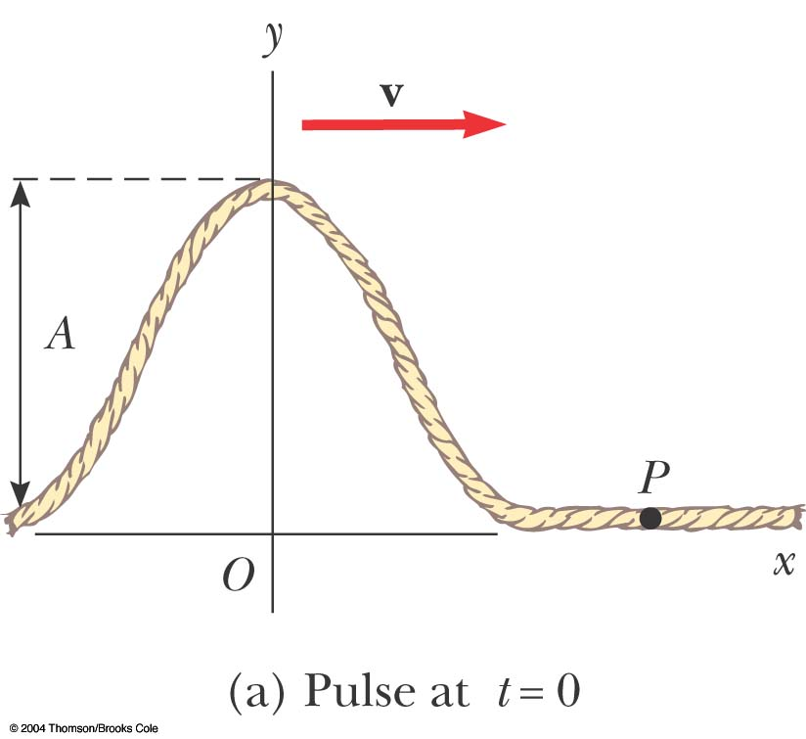
Traveling Pulse
The shape of the pulse at t = 0 is shown
The shape can be represented by
y (x,0) = f (x)
  This describes the transverse position y of the element of the string located at each value of x at
  t = 0

Slide 17
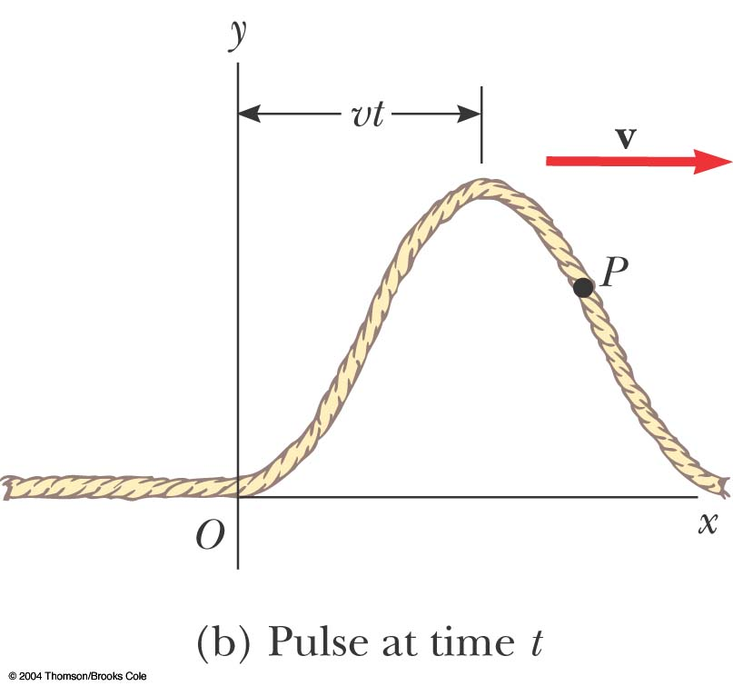
Traveling Pulse, 2
The speed of the pulse is v
At some time, t, the pulse has traveled a distance vt
The shape of the pulse does not change
Its position is now
y = f (x – vt)

Slide 18
Traveling Pulse, 3
For a pulse traveling to the right
  y (x, t) = f (x – vt)
For a pulse traveling to the left
  y (x, t) = f (x + vt)
The function y is also called the wave function: y (x, t)
The wave function represents the y coordinate of any element located at position x at any time t
  The y coordinate is the transverse position

Slide 19
Traveling Pulse, final
If t is fixed then the wave function is called the waveform
  It defines a curve representing the actual geometric shape of the pulse at that time

Slide 20
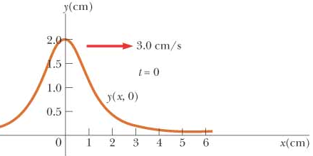
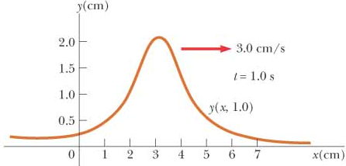
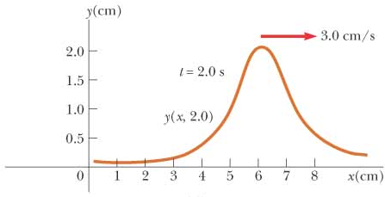
Example 16.1
A wave pulse moving to the right along the x axis is represented by the wave function
where x and y are measured in cm and t is in seconds.
  Plot the wave function at t = 0, t = 1.0 s, and t = 2.0 s.
  Find the speed of the wave pulse.

Slide 21
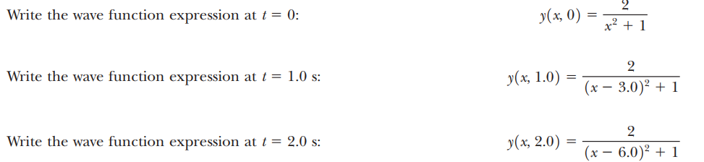
Example 16.1

Slide 22
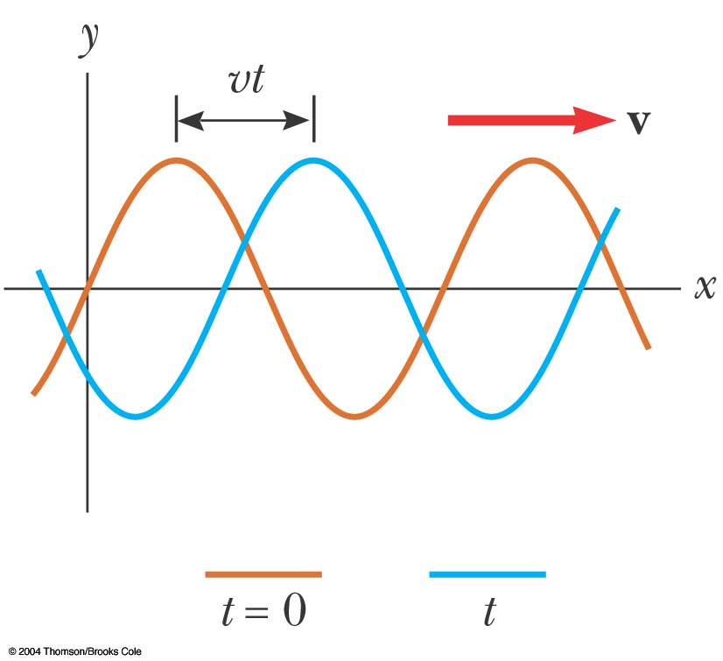
Sinusoidal Waves
The wave represented by the curve shown is a sinusoidal wave
It is the same curve as sin θ plotted against θ
This is the simplest example of a periodic continuous wave
  It can be used to build more complex waves

Slide 23
Sinusoidal Waves, cont
The wave moves toward the right
  In the previous example, the brown wave represents the initial position
  As the wave moves toward the right, it will eventually be at the position of the blue curve
Each element moves up and down in simple harmonic motion
Distinguish between the motion of the wave and the motion of the particles of the medium

Slide 24
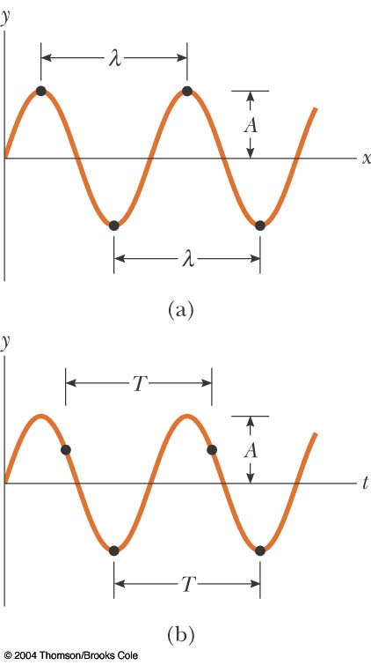
Terminology: Amplitude and Wavelength
The crest of the wave is the location of the maximum displacement of the element from its normal position
  This distance is called the amplitude, A
The wavelength, λ, is the distance from one crest to the next

Slide 25
Terminology: Wavelength and Period
More generally, the wavelength is the minimum distance between any two identical points on adjacent waves
The period, T , is the time interval required for two identical points of adjacent waves to pass by a point
  The period of the wave is the same as the period of the simple harmonic oscillation of one element of the medium

Slide 26
Terminology: Frequency
The frequency, ƒ, is the number of crests (or any point on the wave) that pass a given point in a unit time interval
  The time interval is most commonly the second
  The frequency of the wave is the same as the frequency of the simple harmonic motion of one element of the medium

Slide 27
Terminology: Frequency, cont
The frequency and the period are related
When the time interval is the second, the units of frequency are s⁻¹ = Hz
  Hz is a hertz

Slide 28
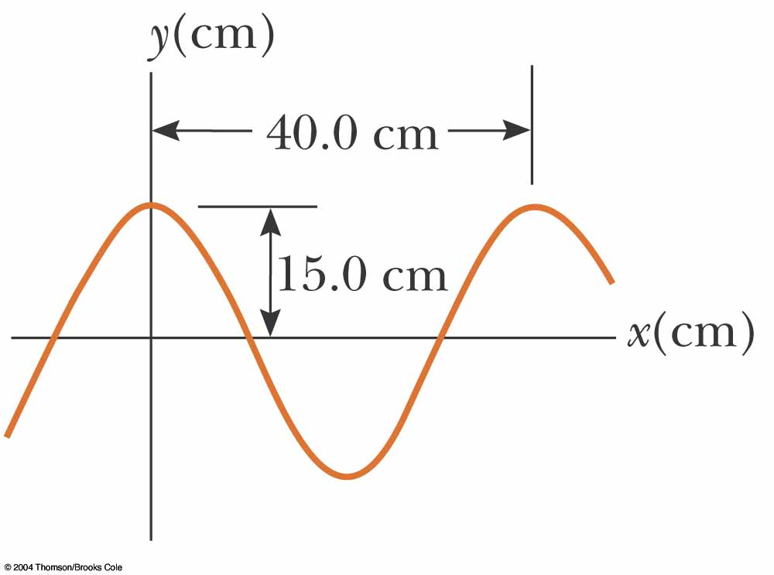
Terminology, Example
The wavelength, λ, is 40.0 cm
The amplitude, A, is 15.0 cm
The wave function can be written in the form
y = A cos(kx – ωt)

Slide 29
Speed of Waves
Waves travel with a specific speed
  The speed depends on the properties of the medium being disturbed
The wave function is given by
  This is for a wave moving to the right
  For a wave moving to the left, replace x – vt with x + vt

Slide 30
Wave Function, Another Form
Since speed is distance divided by time, v = λ / T
The wave function can then be expressed as
This form shows the periodic nature of y

Slide 31
Wave Equations
We can also define the angular wave number (or just wave number), k
The angular frequency can also be defined

Slide 32
Wave Equations, cont
The wave function can be expressed as y = A sin (k x – ωt)
The speed of the wave becomes v = λƒ
If x ≠ 0 at t = 0, the wave function can be generalized to
y = A sin (k x – ωt + φ)
where φ is called the phase constant

Slide 33
Example 16.2
A sinusoidal wave traveling in the positive x direction has an amplitude of 15.0 cm, a wavelength of 40.0 cm, and a frequency of 8.00 Hz. The vertical displacement of the medium at t= 0 and x = 0 is also 15.0 cm, as shown in the figure.
  (a) Find the angular wave number k, period T, angular frequency ω, and the speed v of the wave.
  (b) Determine the phase constant φ, and write a general expression for the wave function.

Slide 34
Example 16.2

Slide 35
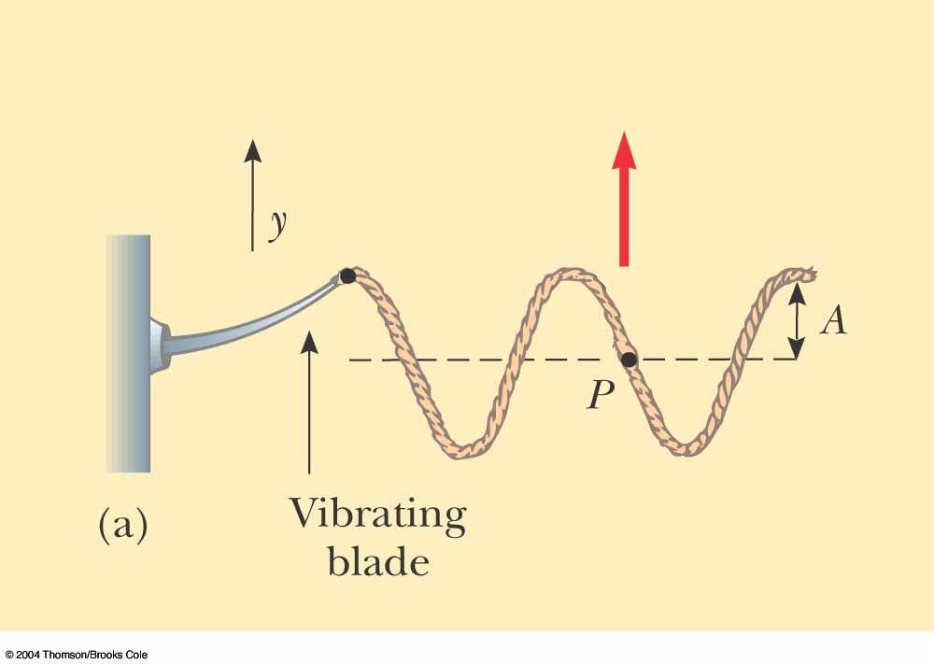
Sinusoidal Wave on a String
To create a series of pulses, the string can be attached to an oscillating blade
The wave consists of a series of identical waveforms
The relationships between speed, velocity, and period hold

Slide 36
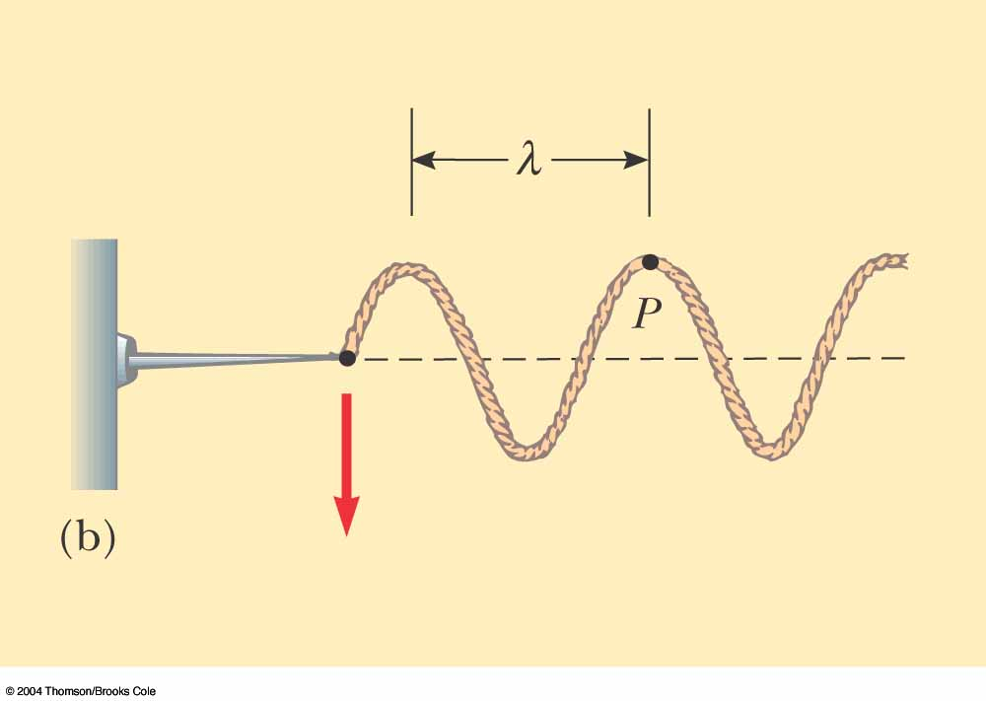
Sinusoidal Wave on a String, 2
Each element of the string oscillates vertically with simple harmonic motion
  For example, point P
Every element of the string can be treated as a simple harmonic oscillator vibrating with a frequency equal to the frequency of the oscillation of the blade

Slide 37
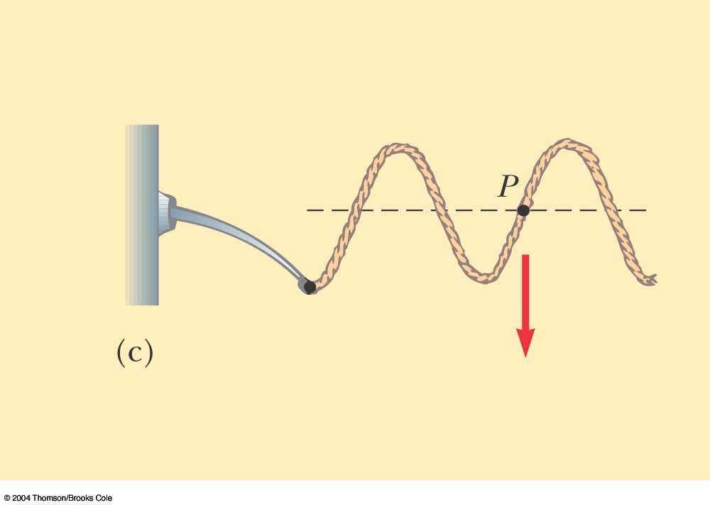
Sinusoidal Wave on a String, 3
The transverse speed of the element is
or v_{y} = -ωA cos(kx – ωt)
This is different than the speed of the wave itself

Slide 38
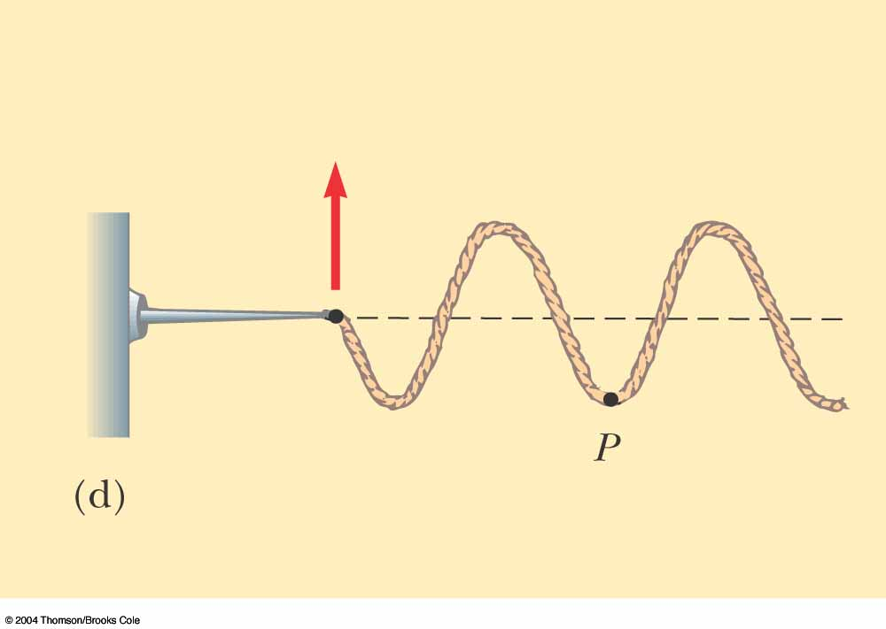
Sinusoidal Wave on a String, 4
The transverse acceleration of the element is
or a_{y} = -ω²A sin(kx – ωt)

Slide 39
The motion of any particle on the string
Assuming wave function is: y = A sin(kx - ωt)
Transverse speed
  v_{y,max}=ωA
Transverse acceleration
  a_{y,max}=ω²A
Example (Problem #17): A transverse wave on a string is described by the wave function
y = (0.120 m) sin [(πx/8) + 4 πt].
  (a) Determine the transverse speed and acceleration at t = 0.200 s for the point on the string located at x = 1.60 m.
  (b) What are the wavelength, period, and speed of propagation of this wave?

Slide 40
Sinusoidal Wave on a String, 5
The maximum values of the transverse speed and transverse acceleration are
  v_{y,} _{max} = ωA
  a_{y,} _{max} = ω²A
The transverse speed and acceleration do not reach their maximum values simultaneously
  v is a maximum at y = 0
  a is a maximum at y = ±A

Slide 41
Speed of a Wave on a String
The speed of the wave depends on the physical characteristics of the string and the tension to which the string is subjected
This assumes that the tension is not affected by the pulse
This does not assume any particular shape for the pulse

Slide 42
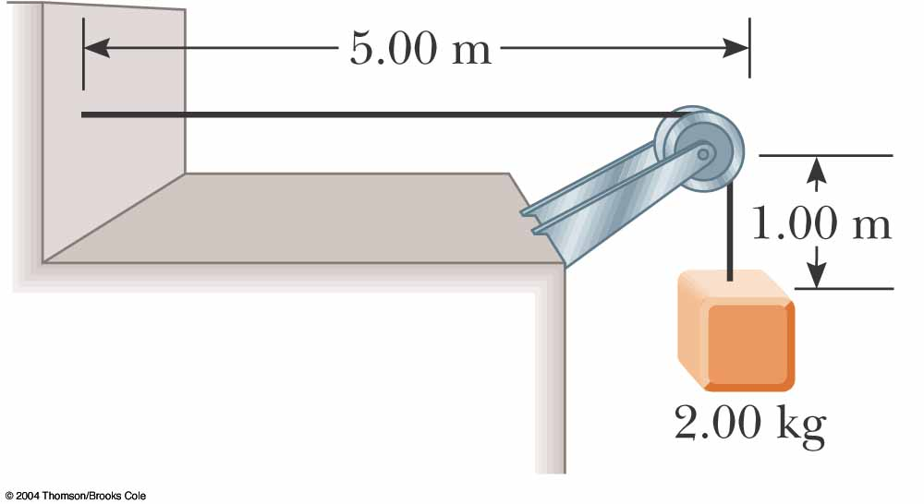
Example 16.4
A uniform cord has a mass of 0.300 kg and a length of 6.00 m. The cord passes over a pulley and supports a 2.00-kg object. Find the speed of a pulse traveling along this cord.

Slide 43
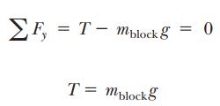



Example 16.4

Slide 44
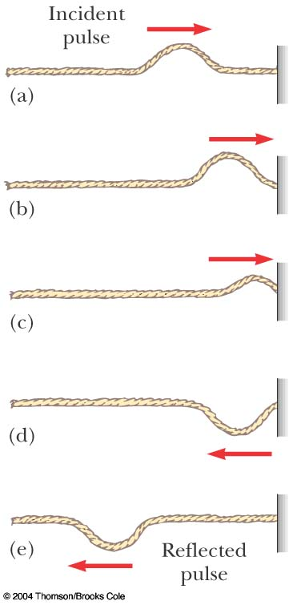
Reflection of a Wave, Fixed End
When the pulse reaches the support, the pulse moves back along the string in the opposite direction
This is the reflection of the pulse
The pulse is inverted

Slide 45
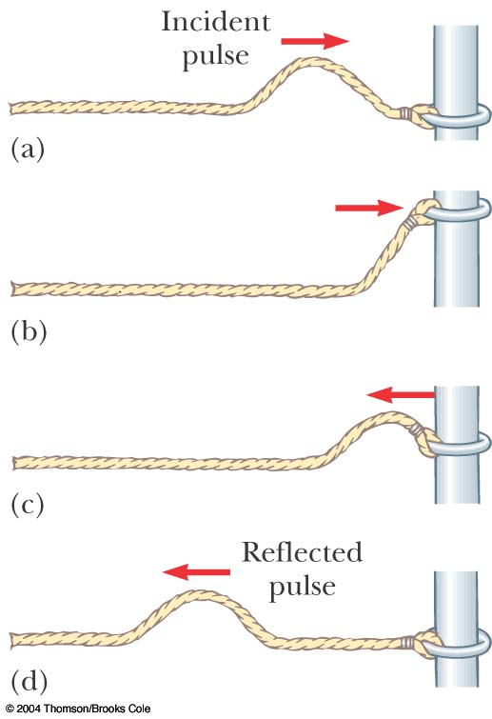
Reflection of a Wave, Free End
With a free end, the string is free to move vertically
The pulse is reflected
The pulse is not inverted

Slide 46
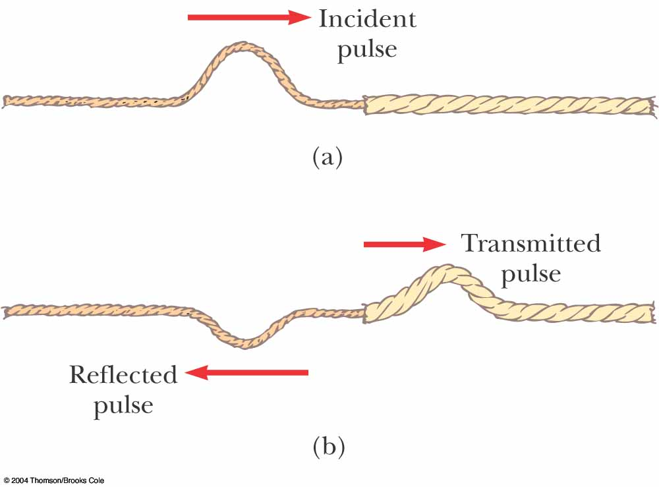
Transmission of a Wave
When the boundary is intermediate between the last two extremes
  Part of the energy in the incident pulse is reflected and part undergoes transmission
    Some energy passes through the boundary

Slide 47
Transmission of a Wave, 2
Assume a light string is attached to a heavier string
The pulse travels through the light string and reaches the boundary
The part of the pulse that is reflected is inverted
The reflected pulse has a smaller amplitude

Slide 48
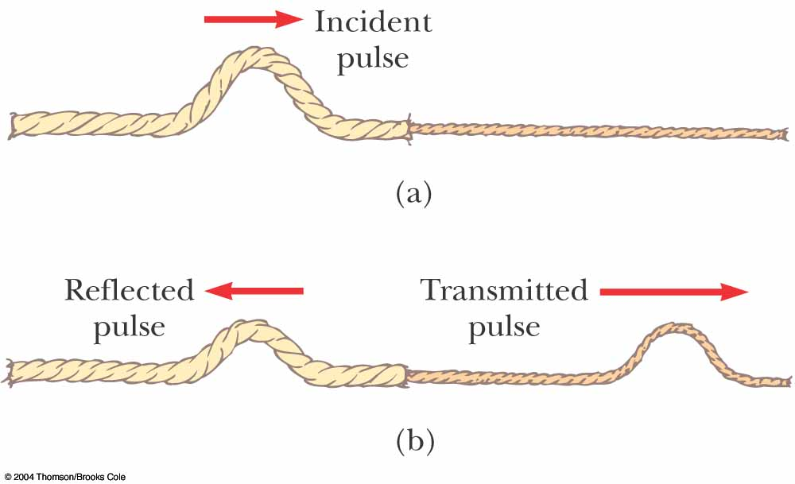
Transmission of a Wave, 3
Assume a heavier string is attached to a light string
Part of the pulse is reflected and part is transmitted
The reflected part is not inverted

Slide 49
Transmission of a Wave, 4
Conservation of energy governs the pulse
When a pulse is broken up into reflected and transmitted parts at a boundary, the sum of the energies of the two pulses must equal the energy of the original pulse

Slide 50
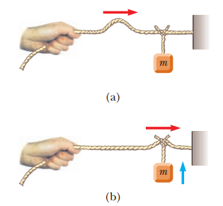
Energy in Waves in a String
Waves transport energy when they propagate through a medium
We can model each element of a string as a simple harmonic oscillator
  The oscillation will be in the y-direction
Every element has the same total energy

Slide 51
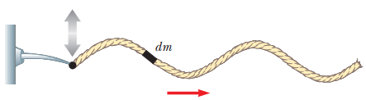
Energy, cont.
Each element can be considered to have a mass of dm
Its kinetic energy is dK = ½ (dm)v_{y}²
The mass dm is also equal to μdx
As the length of the element of the string shrinks to zero, and dK = ½ (μdx) v_{y}²

Slide 52

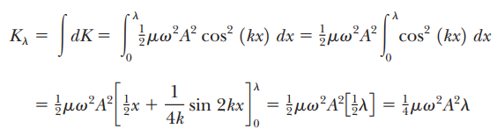
Energy, cont.

Slide 53
Energy, final
Integrating over all the elements, the total kinetic energy in one wavelength is K_{λ} = ¼μω²A ²λ
The total potential energy in one wavelength is
U_{λ} = ¼μω²A ²λ
This gives a total energy of
  E_{λ} = K_{λ} + U_{λ} = ½μω²A ²λ

Slide 54
Power Associated with a Wave
The power is the rate at which the energy is being transferred:
The power transfer by a sinusoidal wave on a string is proportional to the
  Frequency squared
  Square of the amplitude
  Wave speed

Slide 55

Example 16.4
A taut string for which $μ=5.00×{10}^{−2} kg/m$ is under a tension of 80.0 N. How much power much be supplied to the string to generate sinusoidal waves at a frequency of 60.0 Hz and an amplitude of 6.00 cm?

Slide 56
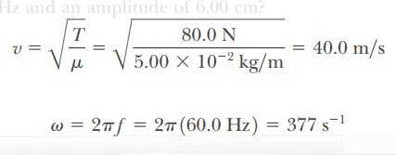
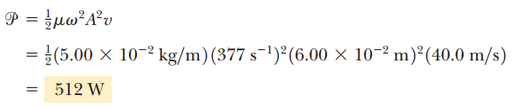

Example 16.4

Slide 57
The Linear Wave Equation
The wave functions y (x, t) represent solutions of an equation called the linear wave equation
This equation gives a complete description of the wave motion
From it you can determine the wave speed
The linear wave equation is basic to many forms of wave motion

Slide 58
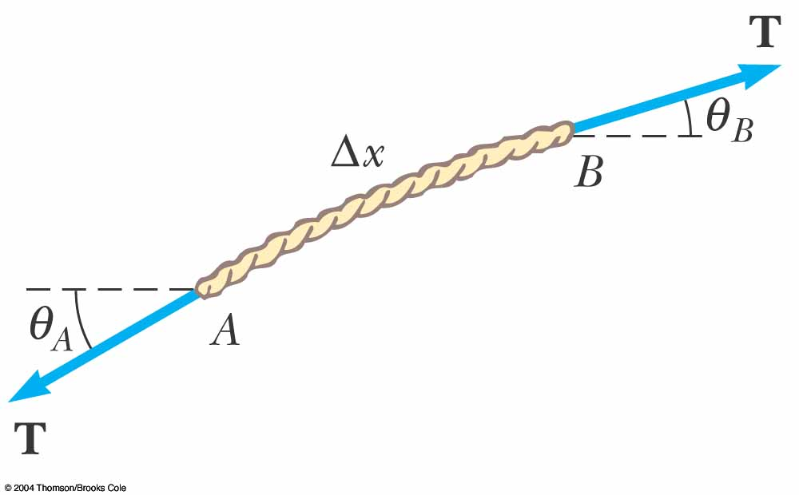
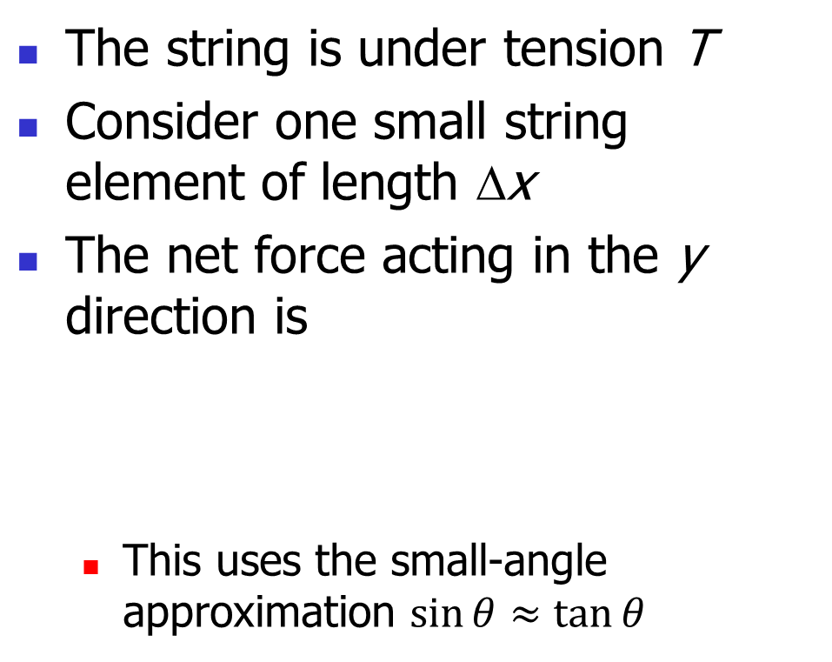
Linear Wave Equation Applied to a Wave on a String
The string is under tension T
Consider one small string element of length Δx
The net force acting in the y direction is
  This uses the small-angle approximation $\sin{θ≈\tan{θ}}$

Slide 59
Linear Wave Equation Applied to Wave on a String
Substituting for the tangents
Mass of the element

Slide 60
Linear Wave Equation Applied to Wave on a String
Applying Newton’s Second Law gives
In the limit as Δx→0, this becomes
This is the linear wave equation as it applies to waves on a string
Standard form of wave equation

Slide 61
Linear Wave Equation and Waves on a String, cont
The sinusoidal wave function represents a solution of the linear wave equation
Applying the sinusoidal wave function to the linear wave equation and following the derivatives, we find that
This verifies the speed of a wave on a string

Slide 62
Linear Wave Equation, General
The equation can be written as
This applies in general to various types of traveling waves
  y represents various positions
    For a string, it is the vertical displacement of the elements of the string
    For a sound wave, it is the longitudinal position of the elements from the equilibrium position
    For em waves, it is the electric or magnetic field components

Slide 63
Linear Wave Equation, General cont
The linear wave equation is satisfied by any wave function having the form
y = f (x ± vt)
The linear wave equation is also a direct consequence of Newton’s Second Law applied to any element of a string carrying a traveling wave

Slide 64
Section 16.2 Problem 5
The wave function for a traveling wave on a taut string is (in SI units)
(a) What are the speed and direction of travel of the
wave? (b) What is the vertical position of an element of
the string at t = 0, x = 0.100 m? (c) What are the wavelength and frequency of the wave? (d) What is the maximum transverse speed of an element of the string?

Slide 65
Section 16.2 Problem 5 (Solution)
The wave function for a traveling wave on a taut string is (in SI units)

Slide 66
Problem 7 and 8
A sinusoidal wave is traveling along a rope. The oscillator
that generates the wave completes 40.0 vibrations in 30.0 s.
Also, a given maximum travels 425 cm along the rope in
10.0 s. What is the wavelength of the wave?
For a certain transverse wave, the distance between two
successive crests is 1.20 m, and eight crests pass a given
point along the direction of travel every 12.0 s. Calculate
the wave speed

Slide 67
Problem 7 and 8
A sinusoidal wave is traveling along a rope. The oscillator
that generates the wave completes 40.0 vibrations in 30.0 s.
Also, a given maximum travels 425 cm along the rope in
10.0 s. What is the wavelength of the wave?

Slide 68
Problem 7 and 8
For a certain transverse wave, the distance between two
successive crests is 1.20 m, and eight crests pass a given
point along the direction of travel every 12.0 s. Calculate
the wave speed

Slide 69
Problem 9
A wave is described by y = (2.00 cm) sin (kx -vt), where k = 2.11 rad/m, ω = 3.62 rad/s, x is in meters, and t is in seconds.
Determine the amplitude, wavelength, frequency, and speed of the wave.

Slide 70
Problem 10
When a particular wire is vibrating with a frequency of 4.00 Hz, a transverse wave of wavelength 60.0 cm is produced. Determine the speed of waves along the wire

Slide 71
Problem 21
A telephone cord is 4.00 m long. The cord has a mass of
0.200 kg. A transverse pulse is produced by plucking one
end of the taut cord. The pulse makes four trips down
and back along the cord in 0.800 s. What is the tension in
the cord?

Slide 72
Problem 22
A transverse traveling wave on a taut wire has an amplitude of 0.200 mm and a frequency of 500 Hz. It travels with a speed of 196 m/s. (a) Write an equation in SI units of the form y = A sin (kx - vt) for this wave.
(b) The mass per unit length of this wire is 4.10 g/m. Find the tension in the wire.

Slide 73
Homework
Ch. 16, P. 506, Problems: #10, 12, 13, 16, 21.
Hints:
  In #10, find the wave speed v first.
  In #12, set the phase difference at point A and B to be: (Phase at B) – (Phase at A) = ± π/3 rad; then solve for x_{B}.

